Slide 1
E-Construction Service

Slide 2
BHOLABHAI PATEL COLLEGE OF COMPUTER STUDIES-GANDHINAGAR
BCA SEM –V-A
BCA 507 PROJECT PHASE-1
Name | Enrollment No. | Roll No.
Patil Nikhil BhikanBhai | 18BCA04193 | 18329
Suthar Akash ArvindBhai | 18BCA04015 | 18344
Shradhay Raj | 18BCA04258 | 18060
TIME LINE : Aug. 2020 to Oct. 2020
TASK 1 To 4
7-08-2020 to 12-09-2020
Guide - Richa Mehta

Slide 3
Index
Task | Title | Page No.
1 | Project Title Project Definition Project Scope/Objective Technology Using in Creating Project | 4
2 | Study of Existing System Advantages and Disadvantages Operational , Technical & Informational Level Problems | 8
3 | Proposed System Advantages And Disadvantages SRS including Functional Requirement And Non-Functional Requirement Feasibility Study | 14
4 | Proposed System Modules Context , First & Second Level DFD | 25
5 | E-R Diagram | 39
6 | Data Directory | 40

Slide 4
PROJECT TITLE
E- Construction Services

Slide 5
PROJECT DEFINITION
The project is a online platform where project’s motive is to provide construction related services such as construction vehicle & The projects provide these vehicles on rent according to the work.

Slide 6
Project Scope/Objective
The project’s main objective is to provide construction related vehicles on affordable rent in rural and urban areas.
The system provide Heavy duty vehicle like Backhoe Loader, Crane, Bulldozer, Boom lift, Excavator, Skid Steer Loader, Driller, etc…
In The System provide hourly or daily basis vehicle on rentals.

Slide 7
Technology Using in Creating Project
The technology is used to creating web site and the front end and back en are as follows
Front end
PHP 7.2.27 version
Back End
MySQL 2.4.41 version
****

Slide 8

Study of Existing System
Equipment Rentals India
The online platform will provide construction related equipments and construction related vehicles on rental services.
The online platform will provide services to end user.
www.equipmentrentalsindia.com

Slide 9
Equipment Rentals India (ERI) Found By Mr. Puneet Chadha in year 2009 incorporated as a company in 2011.
Mr. Puneet started his career with Greaves Cotton Ltd and has worked with companies like ICICI Bank Ltd,
Equipment Rentals India (ERI) is a unit of Clicks & Sales Pvt Ltd.
Clicks & Sales Pvt Ltd. has been a pioneer and web and digital technologies.
Equipment Rentals India(ERI) has offices in New Delhi, Bangalore, Chennai and Mumbai.

Slide 10
Advantages of System
The platform will provide services at anyplace in Mumbai, Chennai,Delhi.
The platform will provide direct connection with client to vehicle owner.
The platform will provide services on good price
Now platform will update time according to work and give extra hours to client.

Slide 11
Disadvantages of System
The platform will providing services only in metro cities.
The platform is not providing services on reasonable cost.
Platform take additional charges according to work with additional hours.
Platform will not give any surety to client if equipment will fail on working site so client will face problem.
They will provide not exact location of machine or equipment.

Slide 12
Operational Level Problems
Common problem such as shortage of staff
Communication gap between client and organisation's staff it may be language or understanding.
Counterfeit billing from staff to organisation.

Slide 13
Technical Level Problems
Lack of Machinery Maintenance.
High Traffic in Server.
Lost GPS Signals from Heavy Machine's GPS locator.

Slide 14
Informational Level Problems
Unsatisfied Client service Reviews.
Fail Marketing strategy.
Lack of awareness about Working with online system of staff.
****

Slide 15
3.1 Proposed System
The project is a online platform where project’s motive is To provide construction related services such as construction vehicle.
The system provide Heavy duty vehicle like Backhoe Loader, crane. Bulldozer, Boom lift, Excavator, skid Steer Loader, Driller etc….
The system provide hourly or daily bases vehicle on rentals.
The system provides good accountability To consumers.

Slide 16
3.2 Advantages of System
It is the easy To give a service of JCB, Crane, Boom Lift etc…
E-construction side using easy and very fast give the services.
E-construction side do used save a client time.
E-construction side try To a satisfied Clients.
E-construction provide employment in rural and urban areas

Slide 17
3.3 Disadvantages of System
One of the disadvantages of e construction is its variable rate.
E-construction increase price in different occasions.
E-construction uses automated system To increase prices based on supply and demand.

Slide 18
3.4 SRS 3.4.1 System Requirement Specification
Client Minimum or Highest | Server Minimum or Highest | Developer Minimum or Highest
Hardware- Processor- 1GHz Highest RAM- 512MB or Highest Hard Disk- 64 GB or Highest | Hardware Processor- 1.8GHz or Highest RAM- 1.75GB×4 or Highest Hard Disk- 500 GB or Highest | Hardware Processor -2.0 GHz or Highest RAM-2.00GB or Highest Hard Disk-500 GB or Highest
Software Operating Software-Windows Xp To Windows 10,Android2.3.6 or Latest Bit- 32bit To 128bit Open Source application softwares such as Google Chrome,Internet explorer,Safari,Mozila Firefox or latest. | Software Operating system- Windows server 2008 or Latest Supported Database- Microsoft MySQL 2005 or Latest. | Software Operating system-Windows XP To Latest Windows. Application Software- Firefox ,Google Chrome Codeing Language Front End- HTML-- PHP 4.01 or minimum Back end- MySQL

Slide 19
3.4.2 Functional Requirements
Login:-
In this Section we Create Unique user id of consumer by it's email authentication or by verifying it's Mobile phone OTP
Password:-
This is always created with some upper case ,Some lower Case and combination of special characters such as $,&,@,#,*etc.
Service Menu page-:
In- this Section it's also knows as dashboard of our project were we provide service's options.
Booking service page:-
This will shows what service consumer is hiring at which price at which place and how much time.
Payment page:-
This page will show the payment receive and which payment method consumer are using at which time at which place .
Service tracker page :-
On this page this shows real time location,Work place,Machine Load ,field appointed person 's details, Contact No. and address of consumer etc .

Slide 20
3.4.3 Non-Functional Requirements
Work Experience:-
In this section reviewing the quality of work
Feedback:-
Taking service's rating
Suggestions:-
In this section what we improve in our project.

Slide 21
3.5 Feasibility study
Feasibility study is carried out based on many purposes To analyze whether software product will be right in terms of development, implantation, contribution of project To the organization etc.
Operational Study
Technical Study
Economical Study
Schedule Study

Slide 22
3.5.1 Operational Study
User friendly Web UI:- The project is belongs To services of construction vehicals so our team makes it easy access of client.
Minimum data usage:- Main motive is To provide services on any connection which will be work in remote areas such as 2G .
Maximize system connectivity:- Basically In construction area connectivity is not quite good so we need To provide Services in each and every remote area where these machines get into demanded
Mobility of Services To Client:- we provide services according To their work.and According To their location.
Optimized Setps of system:- In our system the steps of consuming services were quite less .

Slide 23
3.5.2 Technical Study
Ease To access:- In that project's technology which is used for making User adaptive .
Developed System Language:- In The Project this will using the latest technical language Front End and Back End such as PHP and MySQL.
Machine Management:- Our project will manage by it's own like we say as artificial intelligence.
Site Maintenance:- The project needs every certain time,Site's server needs maintenance.
Using Open Source platform:-For accessing Our platform consumer needs open source platform application ssuch as Opera,Safari, Mozila Firefox Internet explorer Google Chrome etc.

Slide 24
3.5.3 Economical Study
Generate Employment:-This project will generate employment according To work place or in Field work .
Financial plan:- It is medium term planning approximately it's more than 1 year but less than 5 year and this will plan accordingly market situation.
Ease of invest:-For invest in project we will organise bidding system but this will also derived according To situation of market.
Credibility:- Helping decision-makers determine the positive economic benefits To the organization that the proposed project will provide.
Optimized risk:-Our business belongs To service secTor so this is also a positive point for project

Slide 25

3.5.4 Schedule Study
Task | Title | Duration
Week 1 | Project Title Project Definition Project Scope/Objective Technology Using in Creating Project | 07-08-2020 To 22-08-2020
Week 2 | Study of Existing System Advantages and Disadvantages Operational , Technical & Informational Level Problems | 24-08-2020 To 29-08-2020
Week 3 | Proposed System Advantages And Disadvantages SRS including Functional Requirement And Non-Functional Requirement Feasibility Study | 31-08-2020 To 10-09-2020
Week 4 | Proposed System Modules Context , First & Second Level DFD | 11-09-2020 To 22-09-2020
Week 5 | E-R Diagram | 23-09-2020 To 30-09-2020
Week 6 | Data Directory | 01-10-2020 To 10-10-2020

Slide 26
Proposed System Modules
Client’s Registration
Dashboard
Booking
Payment Method
Feedback

Slide 27
1. Registration
Input :-
Client’s details Such as Name, Age, Gender, Permanent address, Gov. ID prof. (aadhar or Voter Id for address verification, Place of work).
Creating Username and Password.
Process :-
Fetching details from Client and fill it up in system’s form.
Creating Profile of client.
Regular Data Sync of Client’s on its work.
Output :-
Making Profile of its Work
Permanent Registration of client.

Slide 28
2. Login
Input :-
Username and password filled by client in section.
Process :-
Username it maybe client’s registered email,
Specified username such as YTraj9089, ThaKash879 or RoylPatil007.
Password is maybe a combination of Uppercase, Lowercase, Special character case, Numeric type.
Output :-
Now the result of login page.
Filling username in section of username block.
Filling Password in section of Password block.

Slide 29
3. Dashboard
Input :-
Now page will show the dashboard of client’s profile in that section this will shows the information of client such as Address, Gender, Location (it may be real time or last) document which he uploaded. It is editable.
Process:-
Logged in system
System shows descriptive format of client’s profile.
Information will be edited by only client.
Output:-
Main Menu with with descriptive format.
Sequential format

Slide 30
4. Booking
Input :-
Selecting Services according client’s requirement.
Takes Request from selected services from service page according to client.
Process :-
Takes requests from service page of selected services
Process the request and convert into Booking by searching or finding the vehicle by system in the client’s required area.
Once system finds the vehicle or service, System will create a unique Booking id number and apply to client.
Request passes to Tracking page.
Output :-
Page shows the descriptive format of Booking . Such as Unique Booking id, working place, Machine owner’s contact details.

Slide 31
5. Billing Section
Input :-
Once Work will be done, A request come from Tracking page,
On that request the Bill will be Generated respectively.
Process :-
Requests give command to system that Calculate the amount according to the working hour of machine or Construction vehicle.
Now will be calculate according on client’s unique Booking id number, exact amount of working hours, working place, Hiring time, Machine Service charge etc.
Once all calculation will be done then the bill will be given to client’s mail and on its whatsapp number as pdf format.
Payment will be accepted as online Such As RTGS/NEFT, Online payment method like paytm, phonepay, mobikwik, BHIM UPI.
If client wants to pay cash so he can pay to our person it maybe Machine Operator or cash collector this person send from project’s headoffice.
Output :-
Now bill will be generated by system according to system’s calculation and provided to Client’s email and whatsapp number then pay via Online platform or Bank transfer.

Slide 32
6. Feedback
Input :-
Giving rating according to our work via Client rating mail.
Giving client’s suggestion section via suggestion support mail.
Process :-
Once payment done by client the system will send a Client rating mail and Suggestion mail to client’s mail and whatsapp number.
Output :-
Page’s main functionality is feedback mail and suggestion mail will be sent to client’s registered mail and whatsapp number.

Slide 33
Context Level DFD
0
Client
Request for vehicle
E-Construction Service
0
Response for vehicle
Request for vehicle
Response for vehicle
Admin

Slide 34
^{1st} Level DFD
Login/
Register
1.0
Login/Register
Confirm Login/Register
Admin
Client
Save Data In Database
Login / Register Database
Booking
2.0
Book A Vehicle
Receive & Confirm The Booking
Save Data In Database
Booking Database
Payment
3.0
Give Payment
Receive The Payment
Save Data In Database
Payment Database

Slide 35
^{2st} Level DFD
Login
1.1
Login
Confirm The Login
Admin
Client
Save Data In Database
Login/Register Database
Register
1.2
Register
Confirm The Register
Save Data In Database
Login/Register Database
Forget Password
1.3
Forget Password
Update Password

Slide 36
Search Vehicle
2.1
Search working vehicle
Request for vehicle
Admin
Client
Book A
vehicle
2.2
Request for Book Vehicle
Confirm The Booking
Save Data In Database
Booking Database
Cancel Booking
2.3
Request for Cancel Booking
Request Accepted for Cancel Booking

Slide 37
Online
Payment
3.1
Give Payment
Get Payment
Save Data In Database
Admin
Client
Payment Database
Save Data In Database
Case
Payment
3.2
Give Payment
Get Payment

Slide 38
E-R DIAGRAM
Fuel
Password
Ragister_Number
State
City
Client
System
vehicle
Address
Email_Id
ID
ID
Model_Number
Birthday_date
Name
Contect_Number
Confirm
Password
Booking
Work
Payment

Slide 39
Data Directory
Client’s Login Table:-
Field_Name | Field_Type | Field_Size | Constrain
Email_id | Varchar | 40 | Unique
Password | varchar | 40 | Not Null

Slide 40
Client’s Registration Table:-
Field_Name | Field_Type | Field_Size | Constrain
ID | Int | 11 | Primary Key
FullName | Varchar | 120 | Not Null
EmailID | Varchar | 100 | Foreign Key
Password | Varchar | 100 | Not Null
ContactNo | char | 11 | Not Null
Dob | varchar | 40 | Not Null
Address | varchar | 255 | Not Null
City | varchar | 40 | Not Null
Country | varchar | 40 | Not Null
RegDate | timestamp | 5 | Not Null
UpdationDate | timestamp | 5 | Not Null

Slide 41
Vehicle Table:-
Field_Name | Field_Type | Field_Size | Constrain
ID | int | 11 | primary key
Vehicles_Title | Varchar | 150 | Not null
Vehicles_Brand | Varchar | 11 | not null
VehicleOverview | longtext | 100 | Not null
PricePerDay | int | 11 | Not null
FuelType | varchar | 100 | Not null
ModelYear | int | 6 | Not null
SeatingCapacity | int | 11 | Not Null
Vimage1 | varchar | 120 | Not null
Vimage2 | varchar | 120 | Not null
Vimage3 | varchar | 120 | Not null
Vimage4 | varchar | 120 | Not Null
Vimage5 | varchar | 120 | Not Null
RegDate | timestamp | 8 | Not null
Updationdate | timestamp | 8 | Not null
V_reg_num | varchar | 10 | Forigen Key

Slide 42
Booking Table:-
Field_Name | Field_Type | Field_Size | Constrain
ID | int | 11 | None
Booking_Number | bigint | 12 | Primary Key
userEmail | varchar | 100 | Foreign Key
VehicleId | int | 11 | Not Null
FromDate | varchar | 20 | Not Null
ToDate | varchar | 20 | Not Null
Addres | Varchar | 255 | Not Null
Status | int | 11 | Not Null
Posting_Date | timestamp | 6 | Not Null
LastUpdationDate | timestamp | 6 | Not Null

Slide 43
USER PANEL

Slide 44
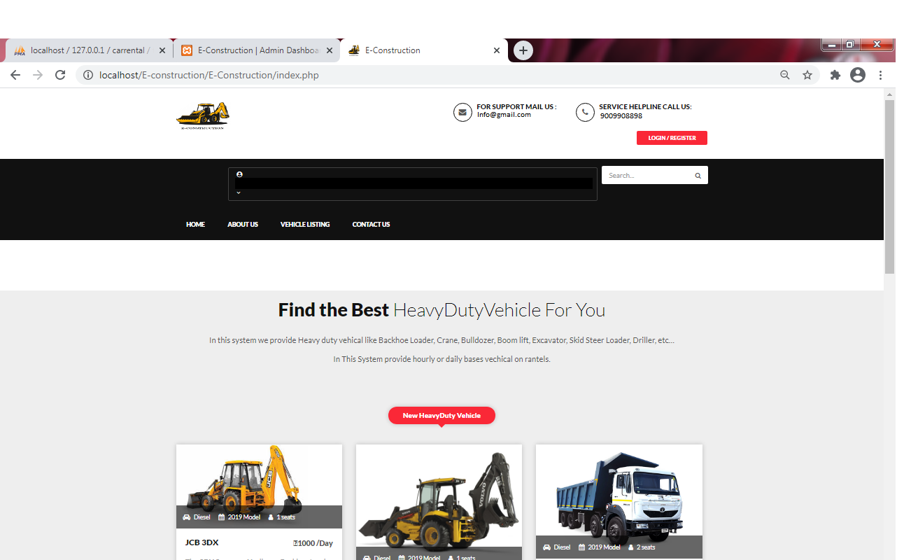
User Panel
The user side of E-construction services .

Slide 45
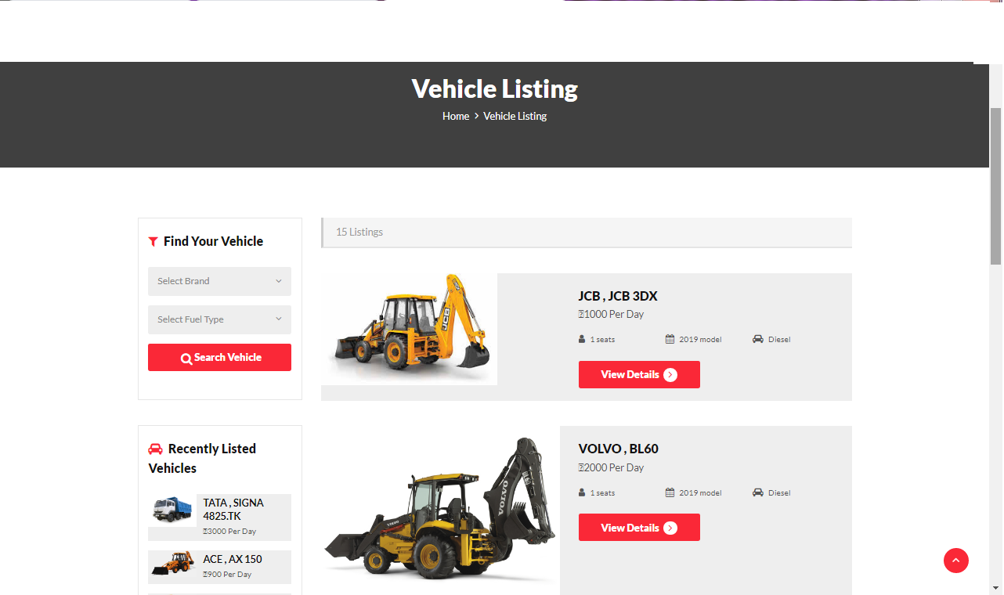
Vehicle Listings
In this here the vehicle listings of e-construction and how to select vehicles in e-construction.
Click on vehicle which user wants to select or he/she need to register him/herself.
Click on the View Details now button .
Click on and Get details and all the information of machine/machines.

Slide 46
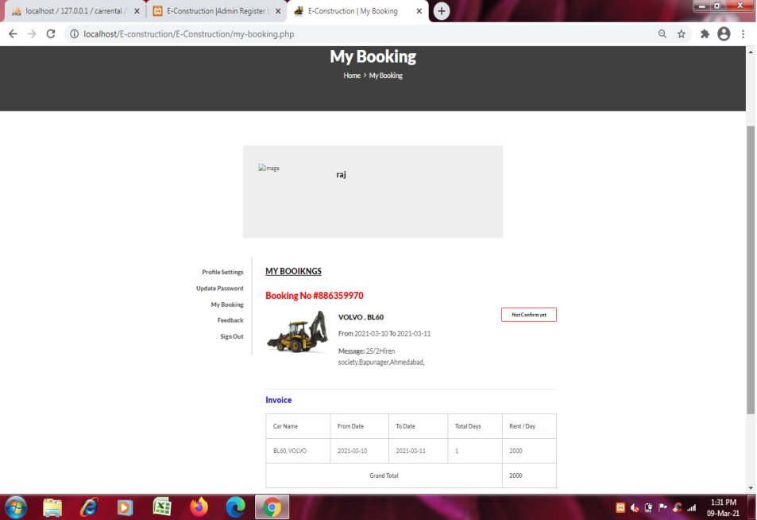
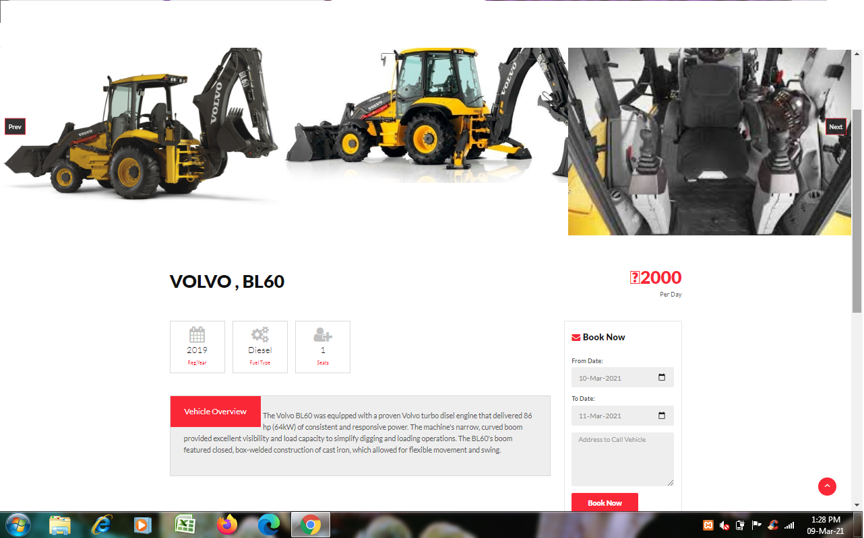
Vehicle Booking
In this section of e-construction how to book a vehicles in e-construction
Then click on date select from to user wants and when he/she wants to needs.
Now Put the Address of user wants to bring the machine.
Then click the book now button.

Slide 47
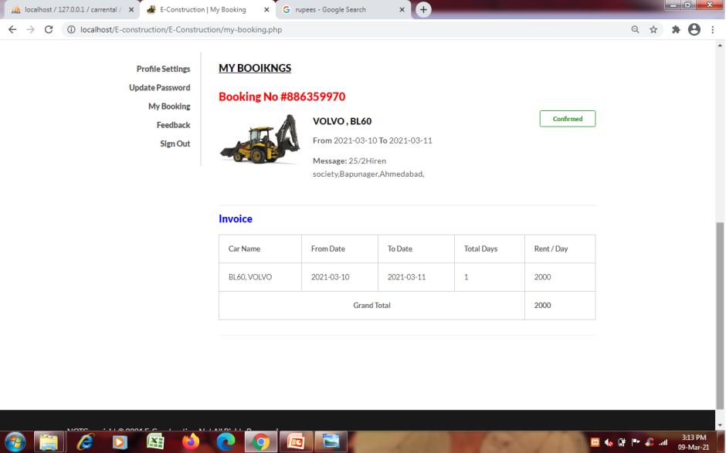
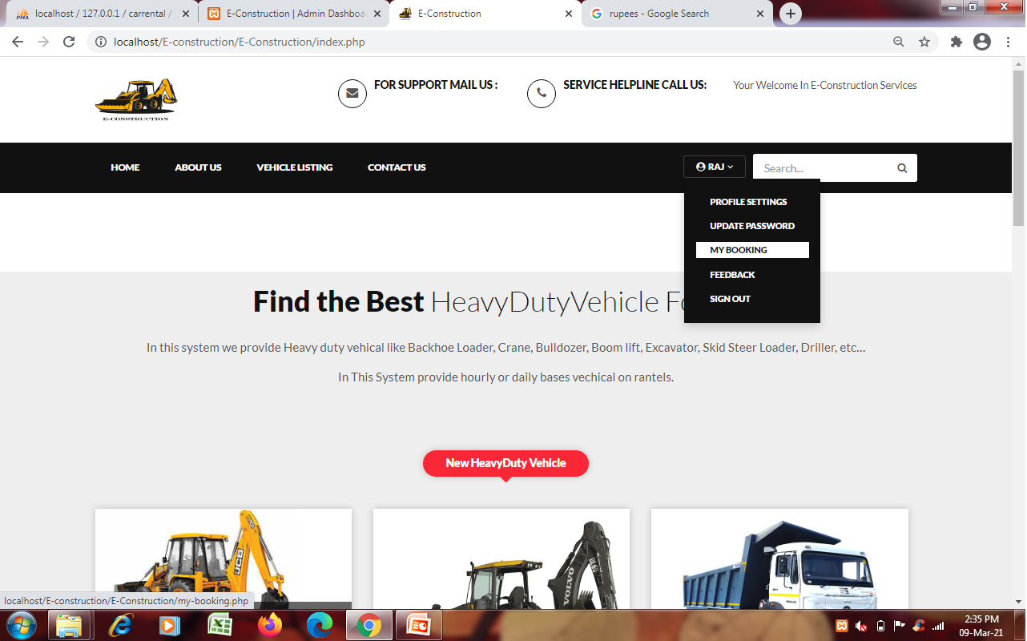
Vehicle Final Booking
Here user can see his bookings.
Click on User id.
Then user find My bookings
Now user gets details and grand
Total.
Now admin team will confirm vehicle.

Slide 48
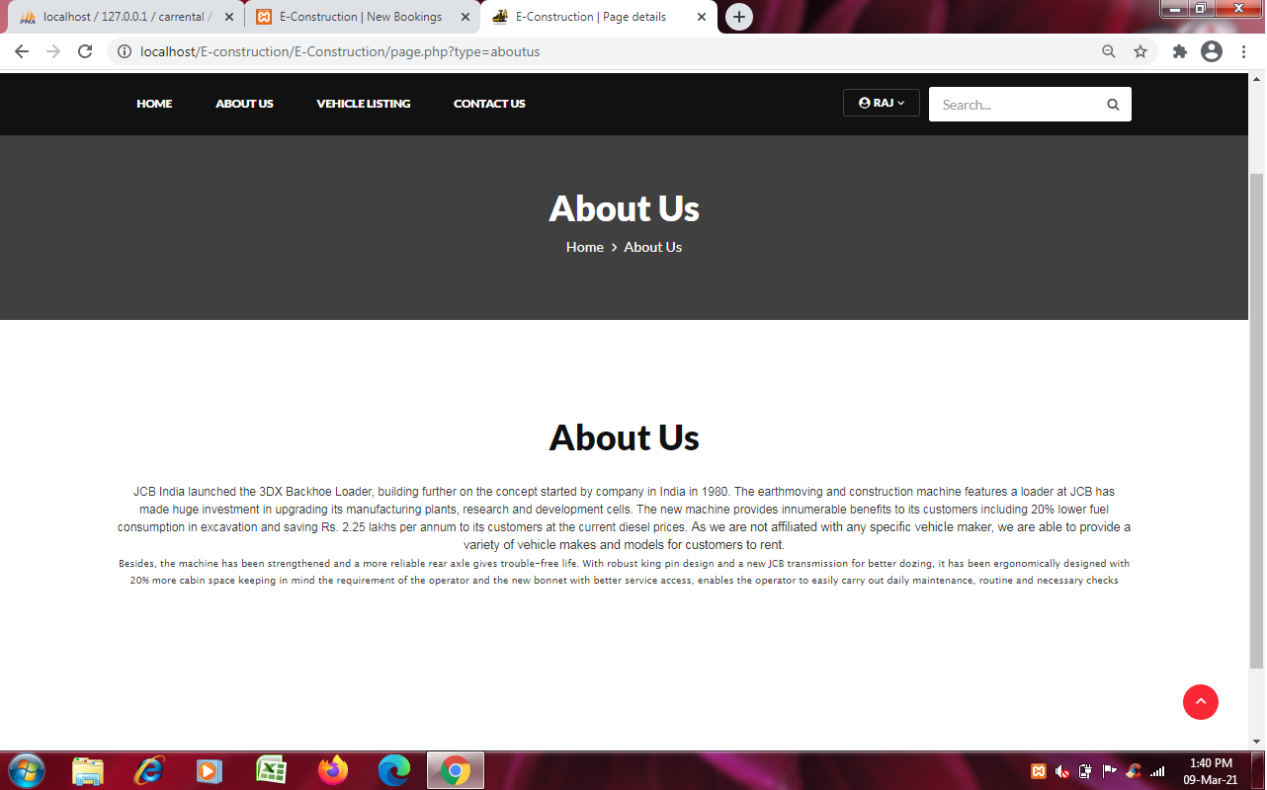
About us

Slide 49
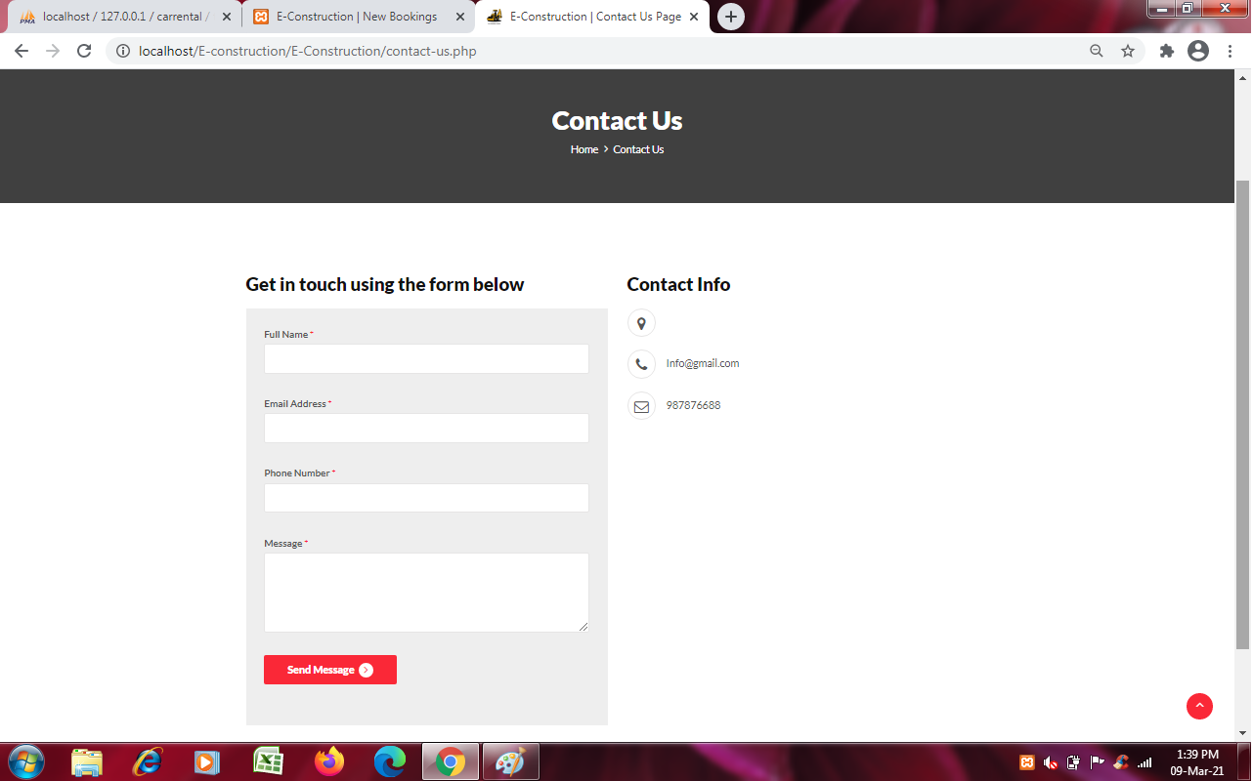
Contact us

Slide 50
ADMIN PANEL

Slide 51
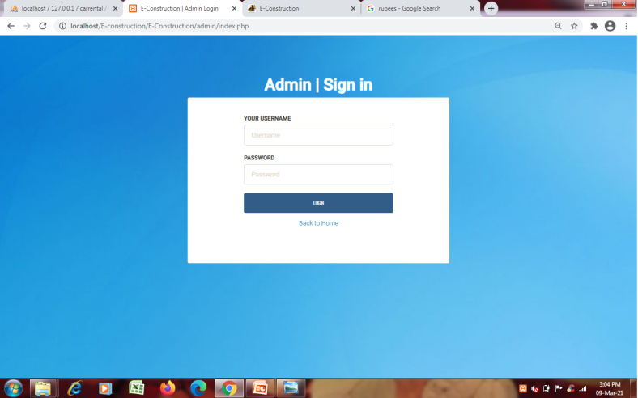
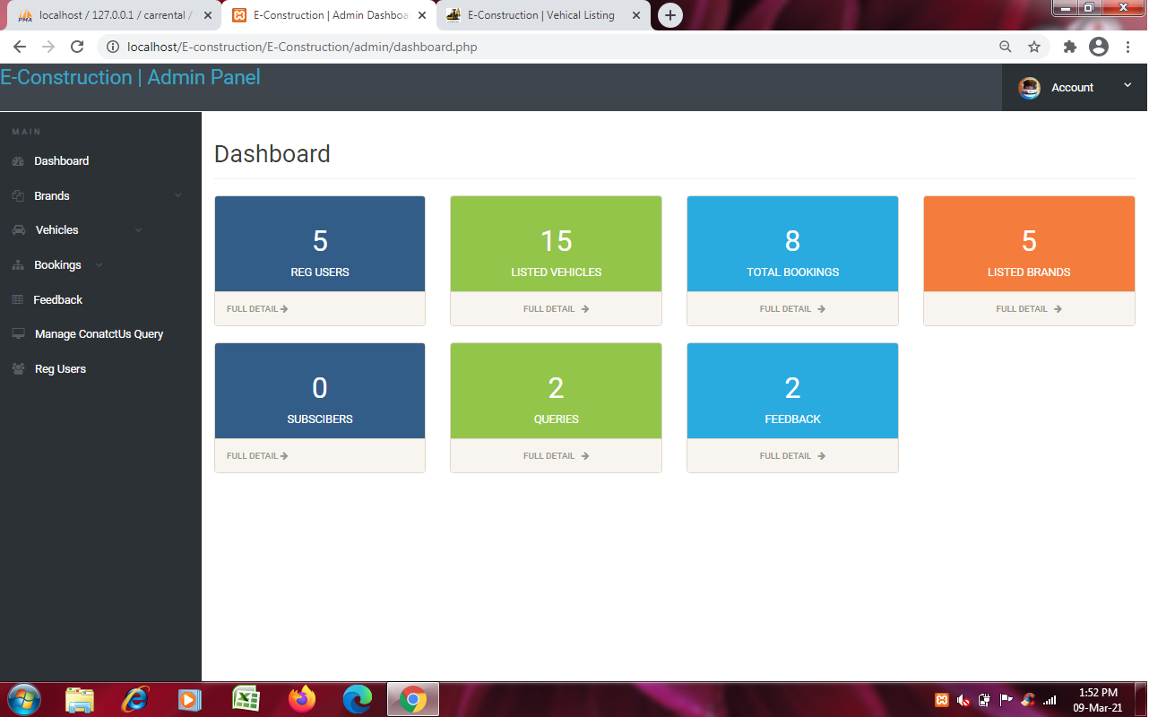
Admin Panel
Now see the admin login side panel of e-construction and its admin’s dashboard layout.

Slide 52
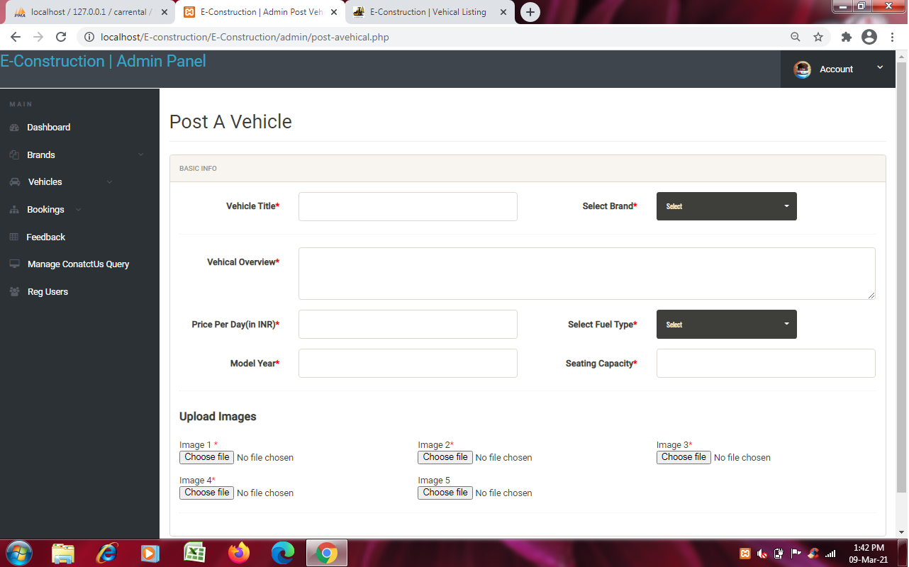
Vehicle Posting
The main function of that page is to register new vehicles in e-construction.

Slide 53
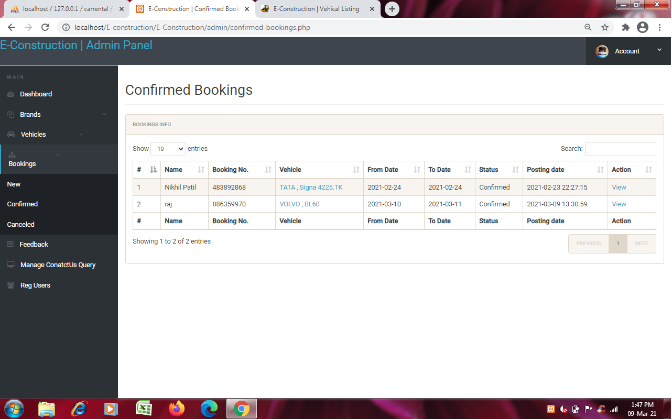
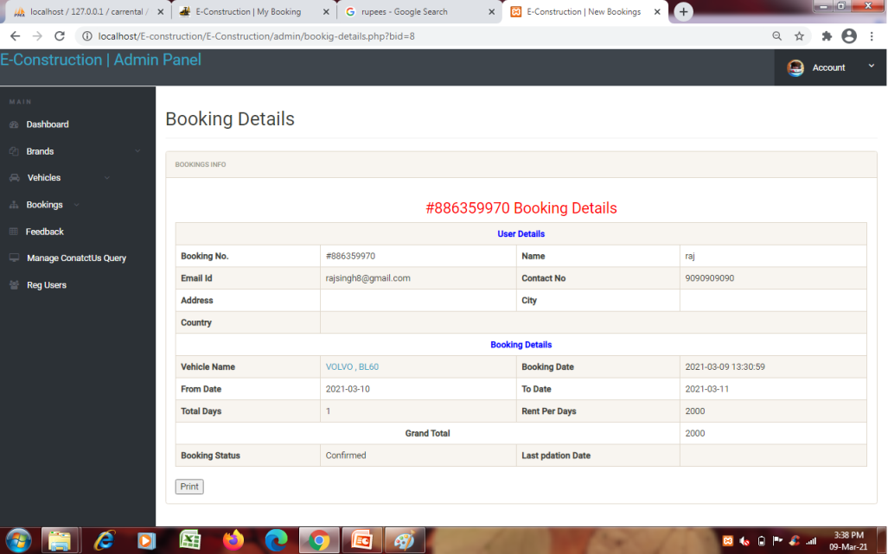
Confirm Booking
The confirm booking page will show the booking and gets confirmed by admin team.

Slide 54
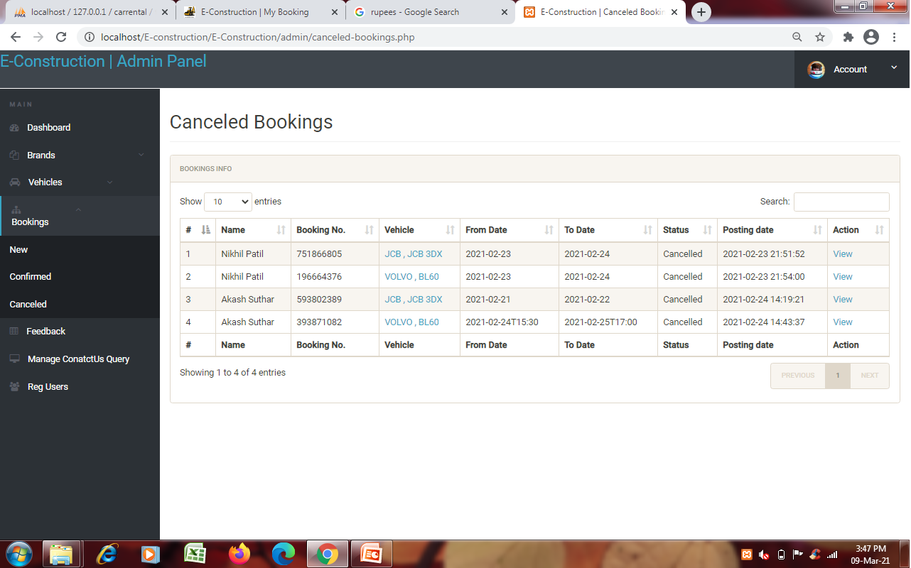
Canceled Booking
The cancel panel will be show the cancel bookings.

Slide 55
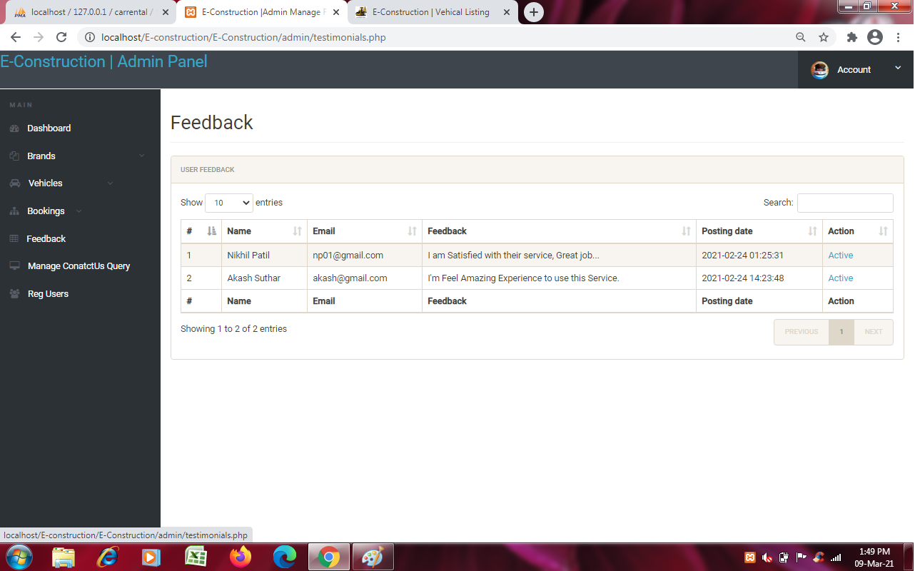
Feedback
In the section of feedback the admin team will be give respond it to users or persons who giving feedbacks.

Slide 56

Manage Contact us Query
The section of manage contact us query is to give response to persons who wants to interested in know information regarding our work.

Slide 57
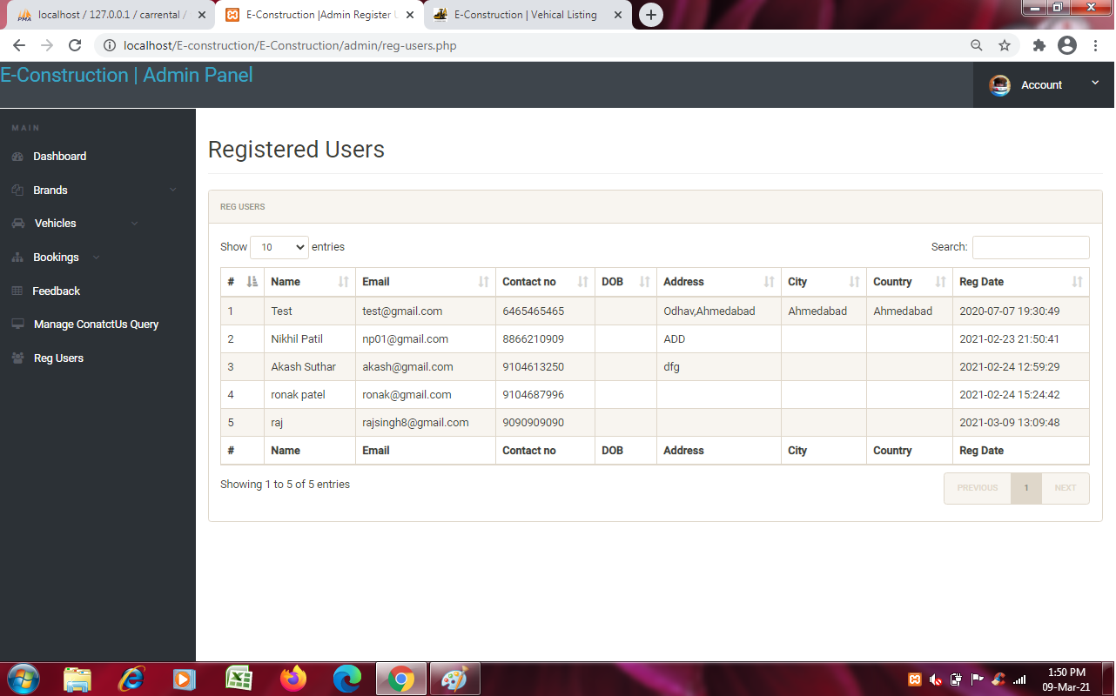
Registered Users
The registered User page will define the users of the which are registered in that website.

Slide 58
THANK YOU ***

